Slide 1

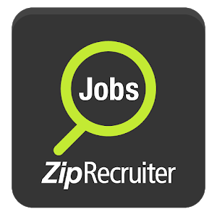
Searching made Simple.
ProMotivate Media Group Inc.

Slide 2
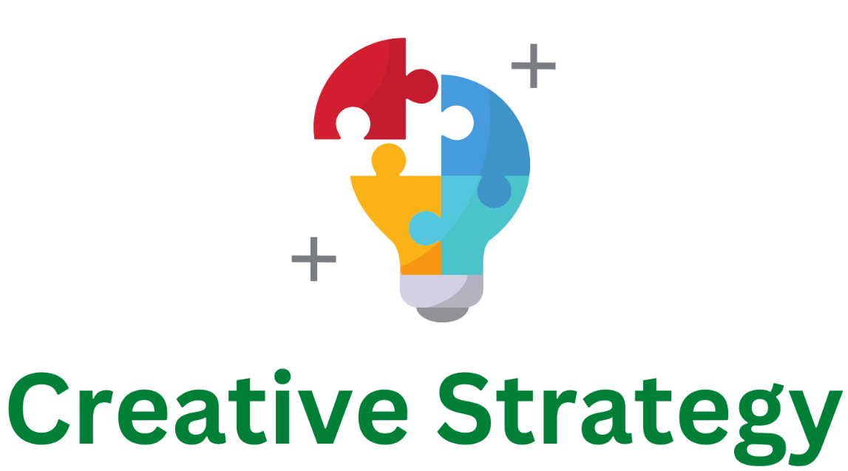


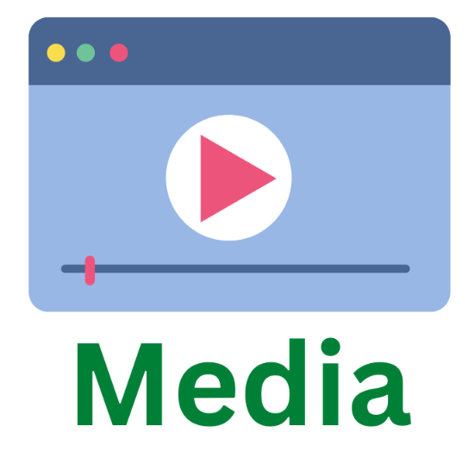
Chloe Lourenco-Lang

Slide 3
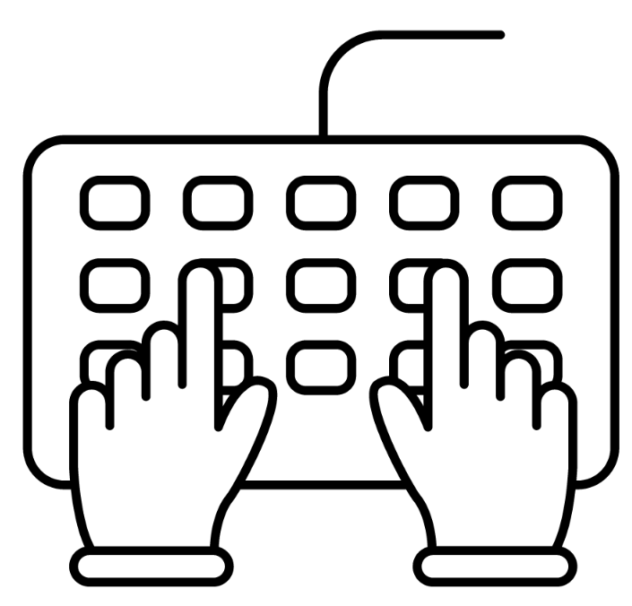
Gen Z Job seekers have specific expectations and intentions
Our research led us to the conclusion ...
Tailored Job Searching
Media Preferences
Less brand loyal than previous generations
Value being able to find companies that meet their specific wants & needs.
Mobile devices and video ads
Internet is the top resource
Top platforms are Instagram, Facebook, Twitter, & desktop displays such as YouTube and Google
“Incremental Reach Across Platforms,” Pace University Library Remote Database Authentication (Simmons Insights), accessed November 1, 2022, https://insights-mrisimmons-com.rlib.pace.edu/essentials/quickreports.
“Simmons Insights.” MRI. Accessed November 1, 2022. https://insights.mrisimmons.com/essentials/quickreports.
Thang Nguyen Ngoc et al., “Generation Z Job Seekers’ Expectations and Their Job Pursuit Intention: Evidence from Transition and Emerging Economy,” Sage Journals, July 2022, https://journals.sagepub.com/doi/full/10.1177/18479790221112548.
Chloe Lourenco-Lang

Slide 4



and 18-24 year old’s don’t like exhaustive job searching and won’t work for just any company
Concerns
Gen Z browses job opportunities, but not for long
Time consuming
Lack of face to face connection
Chloe Lourenco-Lang
Team, Yello. “Everything You Need to Know about Recruiting Generation Z.” Yello, September 23, 2022. https://yello.co/blog/recruiting-generation-z/

Slide 5



Consumer Profiles
Example consumer profiles to represent different stages in the buyer’s journey
Julia Smith (18)
Ryan Miller (21)
Alicia Jones (24)
Long Island, NY
Freshman in college
Wants to browse career options and availability
Philadelphia, PA
Recent college graduate
Wants to begin job searching for a first job he truly loves
Chicago, IL
Unemployed
Eager to find a job that aligns with her values
Chloe Lourenco-Lang

Slide 6
Creative Strategy
And Execution

Slide 7




Our research led us to …
KEY INSIGHT
MESSAGE
18-24 year olds value job search platforms they can easily tailor to their wants and needs.
With ZipRecruiter you can easily search for jobs anywhere anytime and quickly find the job that is your perfect match.
REASON TO BELIEVE
POSITIONING
ZipRecruiters investment in AI technologies ensures their commitment to generating the most accurate and tailored search for job seekers.
ZipRecruiter is the place to search for job opportunities tailored to your wants and needs, connecting you with your perfect job.
Chloe Lourenco-Lang

Slide 8

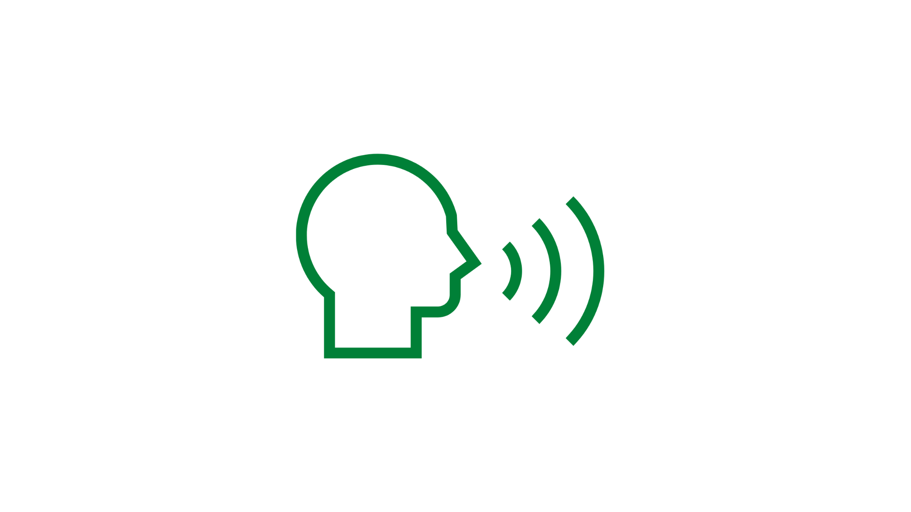

We will execute our findings through this creative strategy…
ORGANIZING IDEA
We will show different types of GenZ individuals in various settings such as holding a diploma at graduation, on site doing construction work, and browsing jobs at home. They will be on ZipRecruiter using an online device, filtering through career preferences and workplace values, helping them find a job that is their perfect match.
TONE
TAGLINE
Hopeful & Inspiring
Searching made Simple.
Chloe Lourenco-Lang

Slide 9
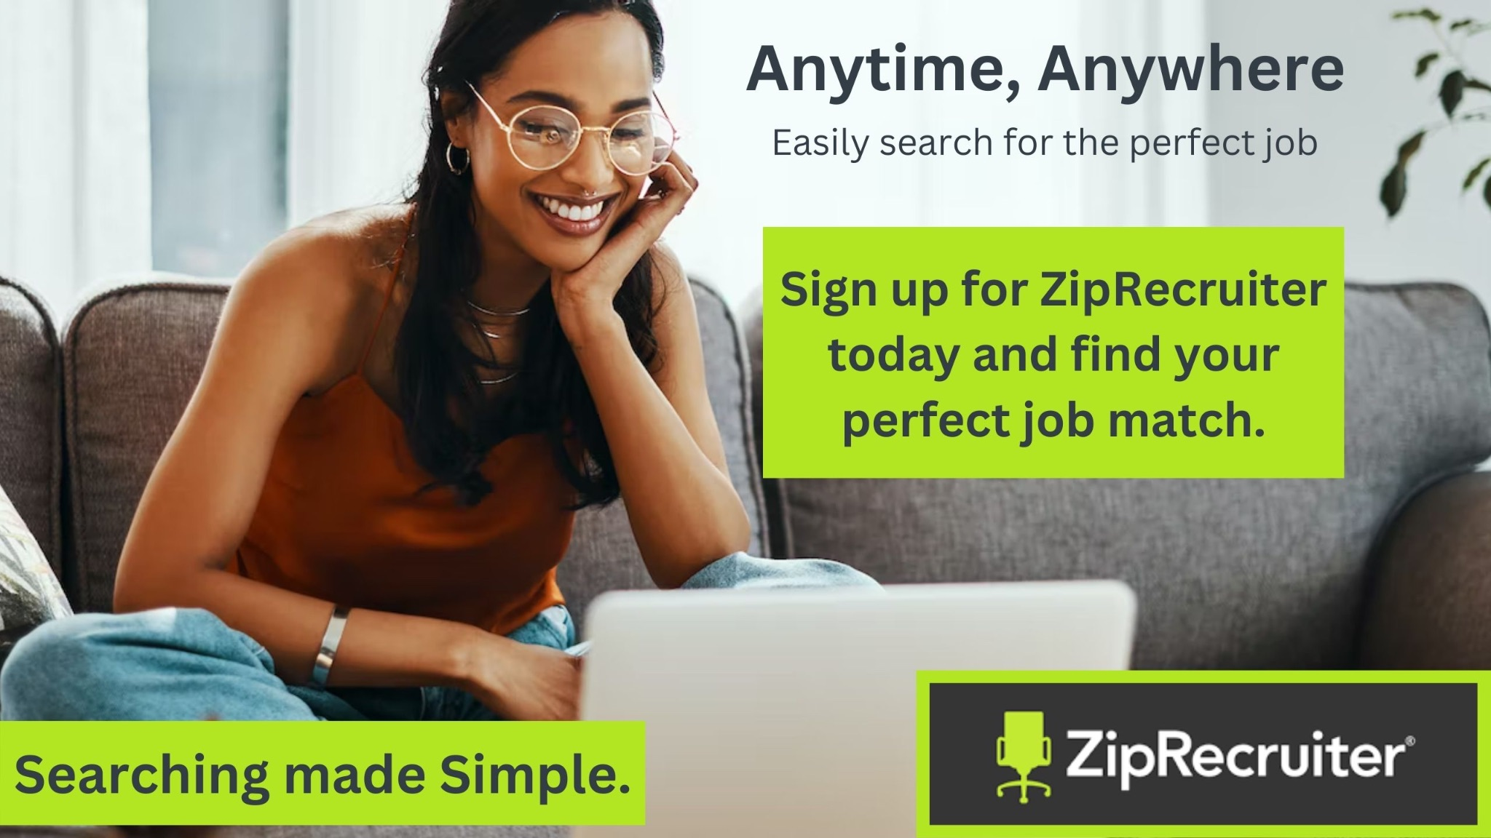
Our Print and Digital Ads will convey ZipRecruiter’s message to Gen Z
Headline
Subheadline
Body Copy & CTA
Illustration
Tagline
Logo
Chloe Lourenco-Lang

Slide 10
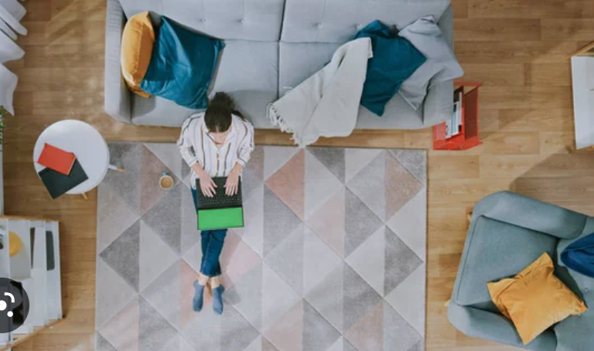


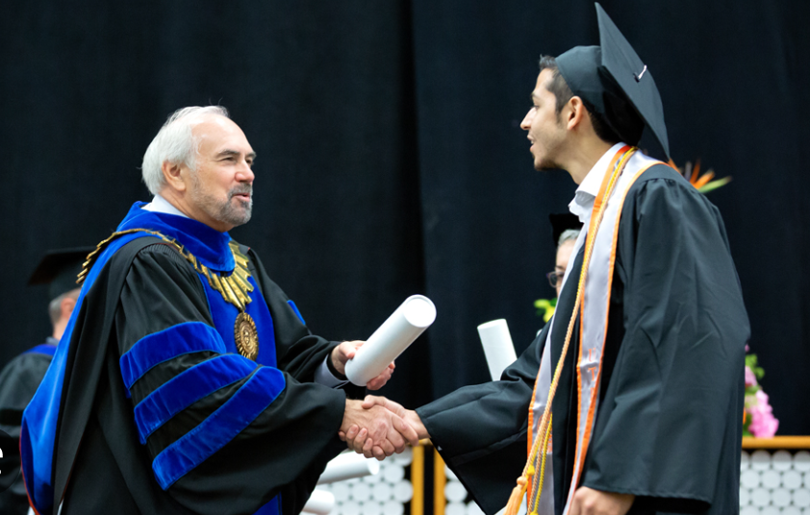
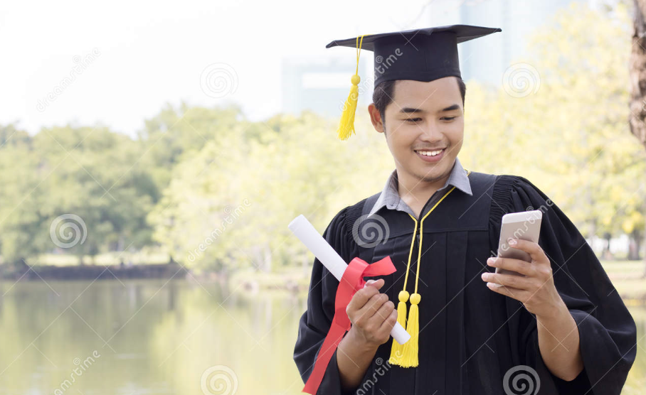
The Storyline of our Video Ad
TIME
0:01
0:07
0:10
0:14
0:18
IMAGE
Voice Over:
*Crowd cheering* Ryan just graduated. With no time to waste, he updates his preferences to show jobs that require a bachelor's degree. ZipRecruiter can get to work connecting him with job opportunities matched perfectly for him before he the ceremony is over”
AUDIO
“Meet Julia. Working hard from home, she is aimlessly scrolling job postings that aligns with her ideal next career move. She stumbles across ZipRecruiter, enters her preferences and is provided with matches in seconds.”
Bird eye view - Wide angle shot of woman on couch, bored aimlessly scrolling through job posting
Switches to upclose shot of her navigating to ZipRecruiter to enter her preferences and information
Seconds later, face of relief as she is matched with job opportunities that fit her criteria
College graduate walks across stage to receive diploma
Immediately opens phone to ZipRecruiter to update his education level
VIDEO
Dana Bosland

Slide 11
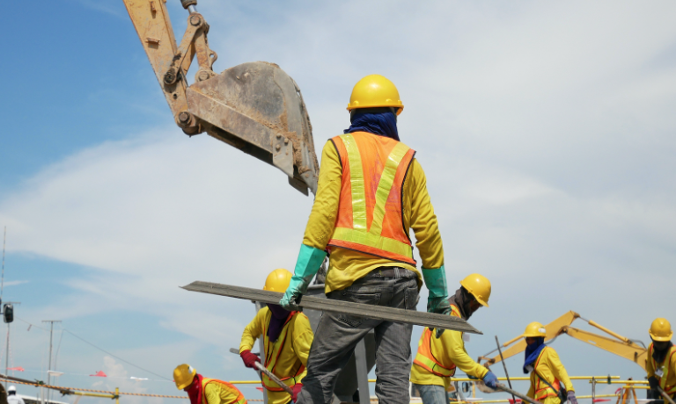

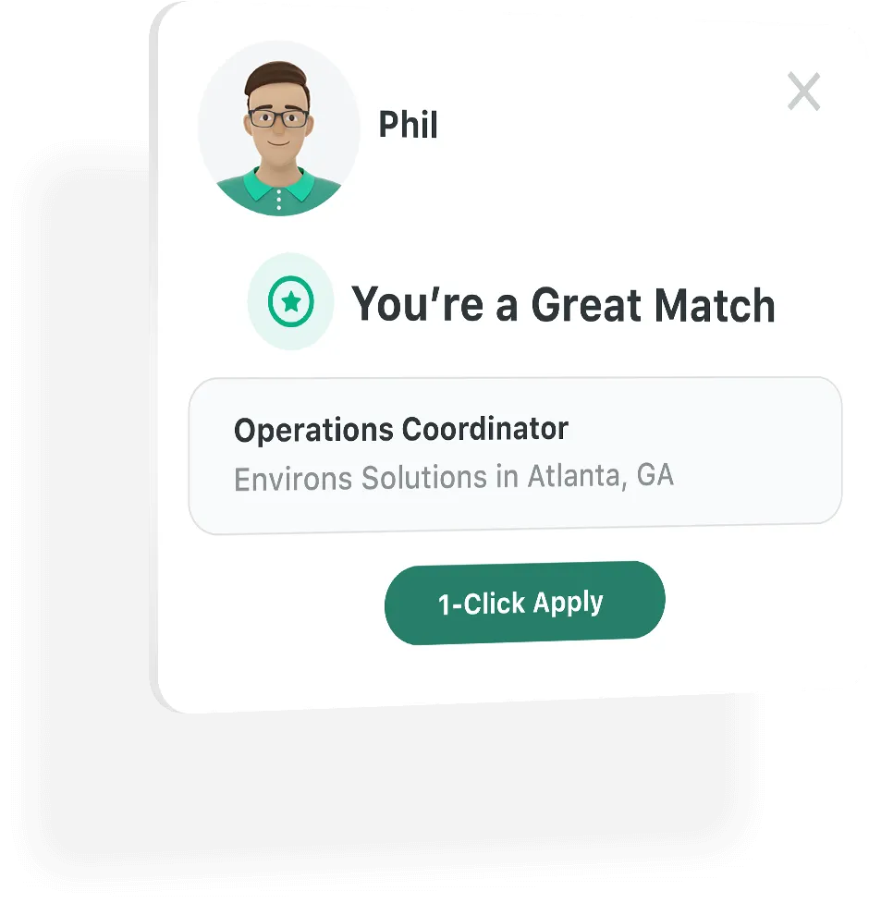
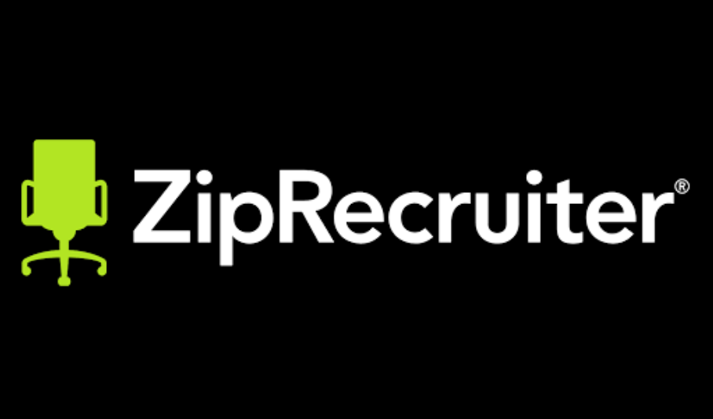
The Storyline of our Video Ad
TIME
0:22
0:25
0:28
0:30
IMAGE
“Job opportunities tailored to you. Created to meet you where you are in your career journey and help you find your perfect job match. ZipRecruiter. Searching made simple.”
Voice Over:
Here's John hard at work. *Ding* Check it out. Job match. 1 click apply.
AUDIO
Bird eye view - Wide angle shot of construction worker on site
*Notification sound* Close up of him smiling at his phone
Notification from Phil reveals a job opportunity match
Black screen flash, ZipRecruiter logo appears on the screen
VIDEO
Dana Bosland

Slide 12
Media
Building brand awareness through the media.

Slide 13
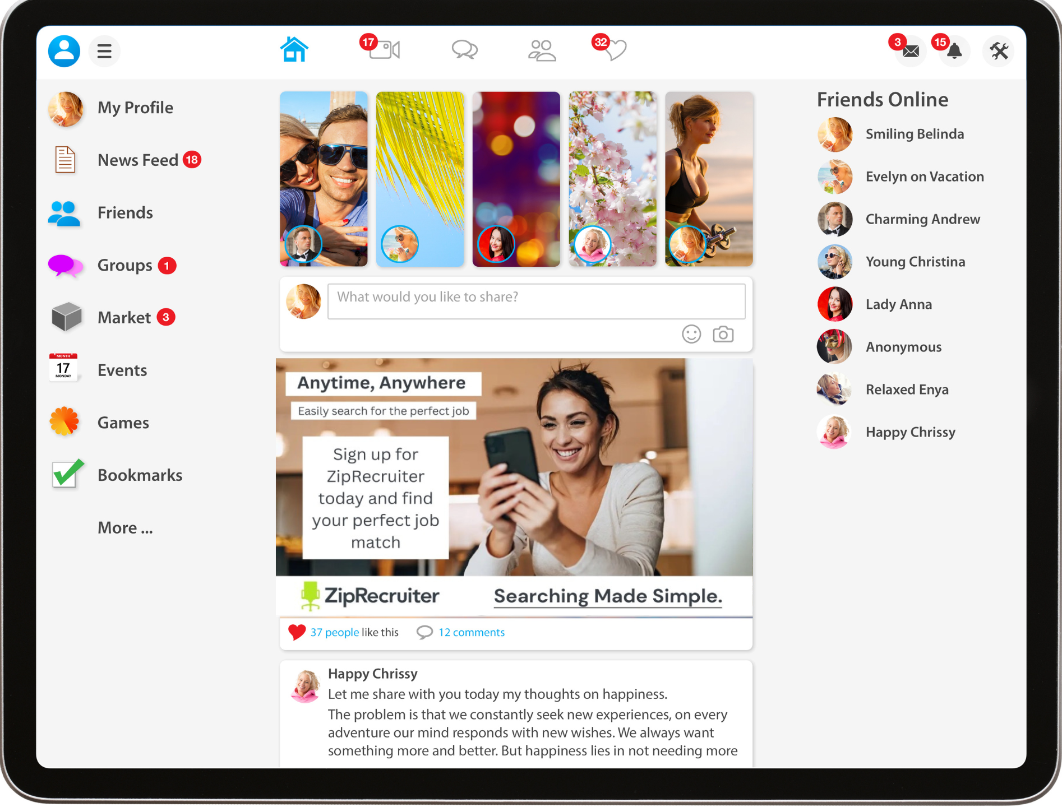

Top Print Magazines for 18–24-year old's
People’s Magazine
Cosmopolitan Magazine
National Geographic
In Feed Digital Facebook Ads
“What Magazines Are Millennials & Gen Z Actually Reading?,” YPulse, July 15, 2019, https://www.ypulse.com/article/2017/10/16/what-magazines-are-millennials-gen-z-actually-reading/.
Chloe Lourenco-Lang

Slide 14

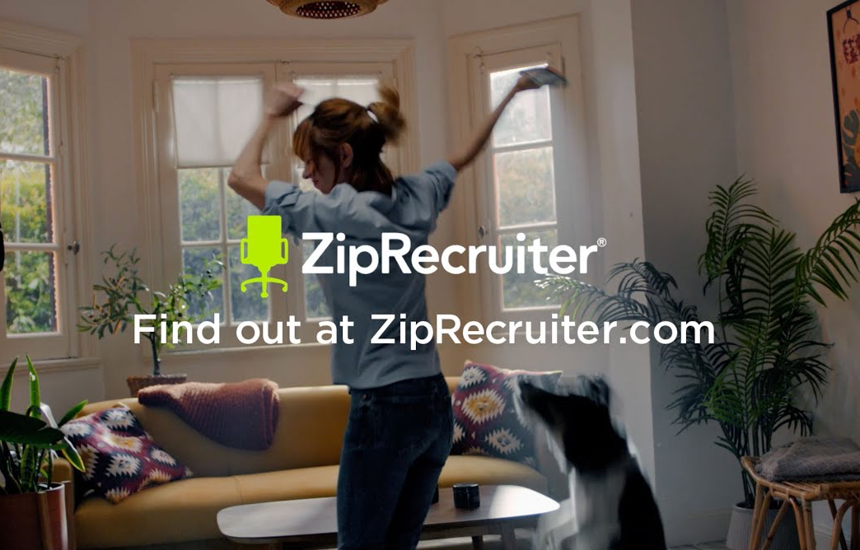
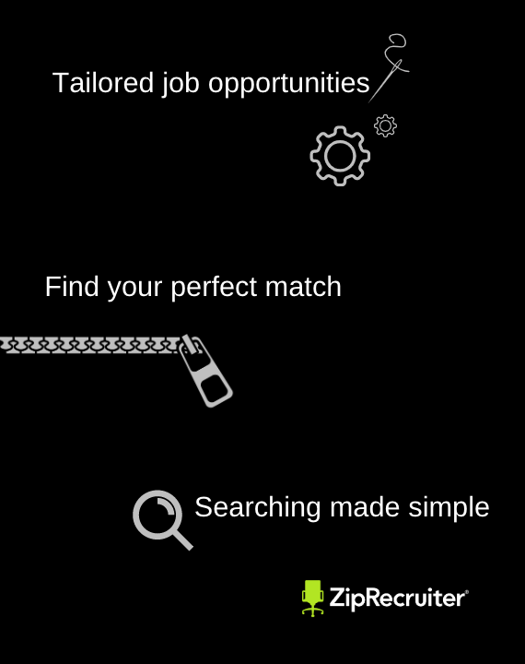
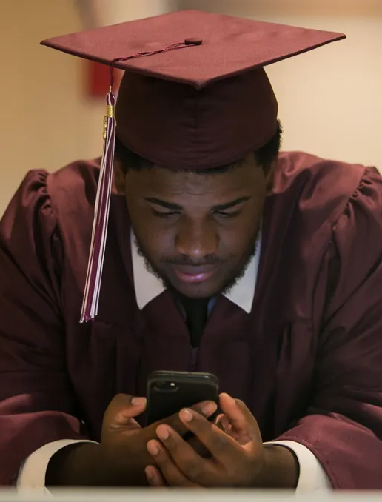
Our ads will be placed on top platforms for 18-24 year old's
Paid Media
Mobile Devices
Desktop
Chloe Lourenco-Lang & Dana Bosland

Slide 15
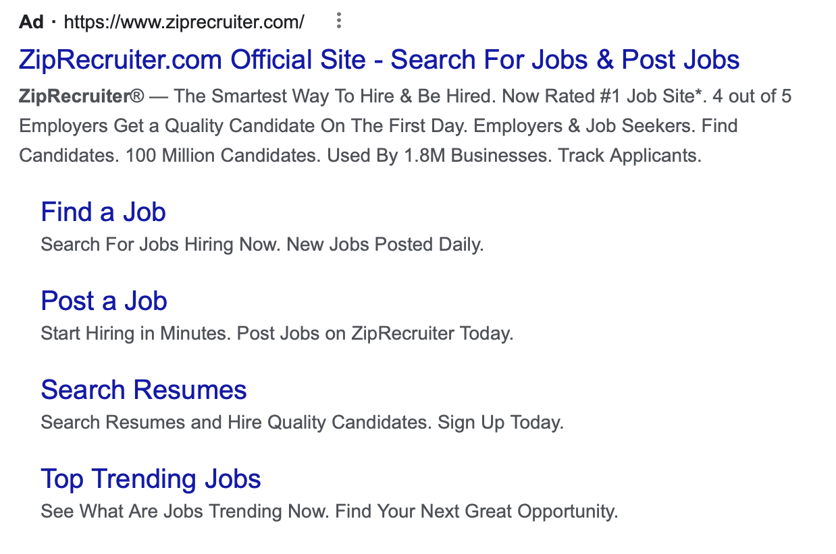
Google Ads on Mobile and Desktop Devices
We will focus on Search Engine Optimization for ZipRecruiter’s high quality and credible website content.
Chloe Lourenco-Lang

Slide 16
Strategy Integration

Slide 17
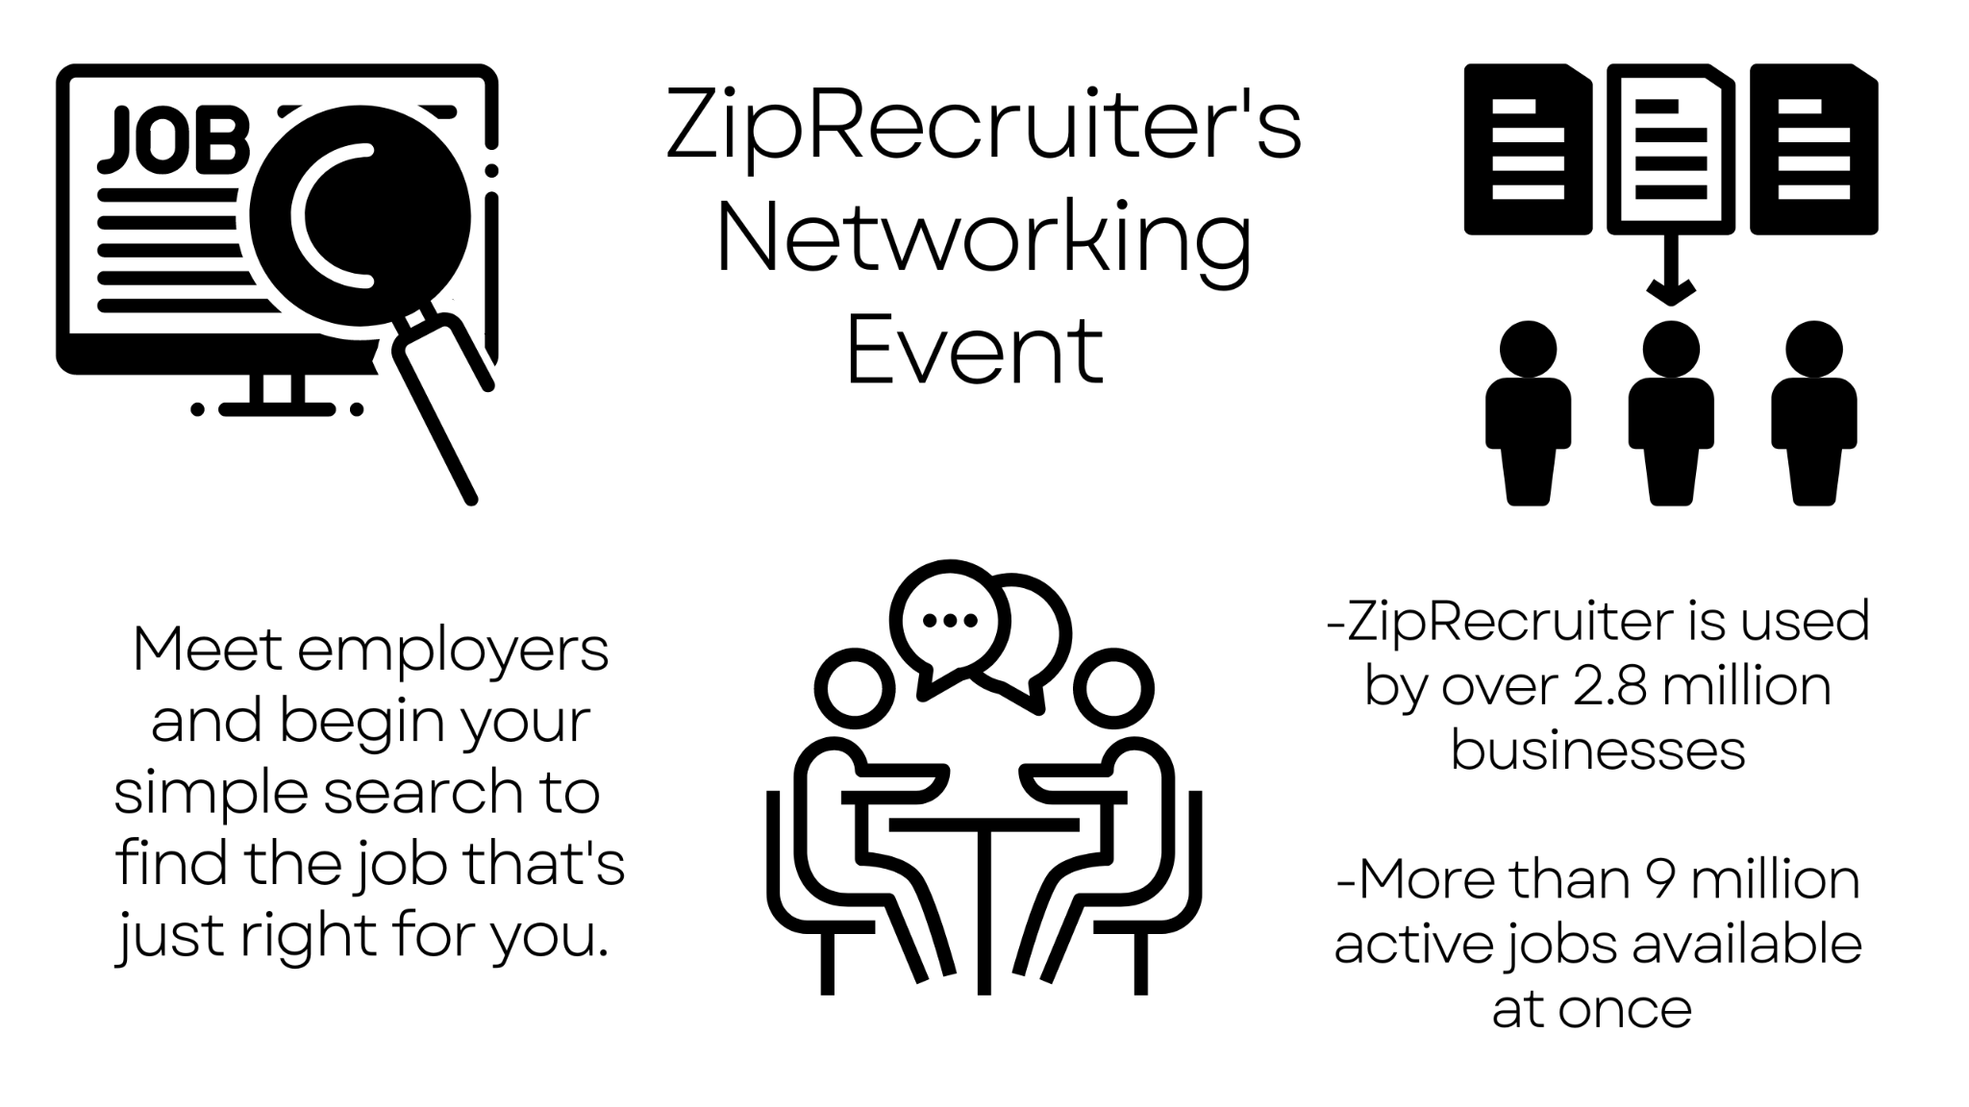
Chloe Lourenco-Lang

Slide 18
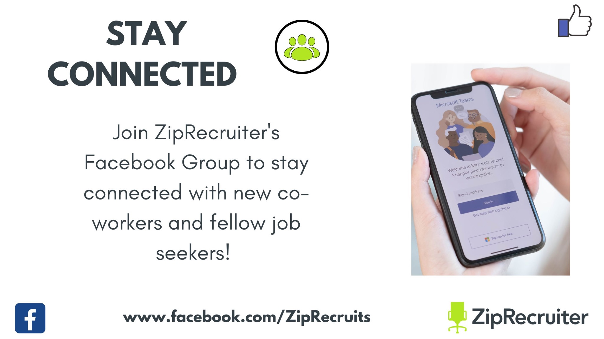
Chloe Lourenco-Lang

Slide 19


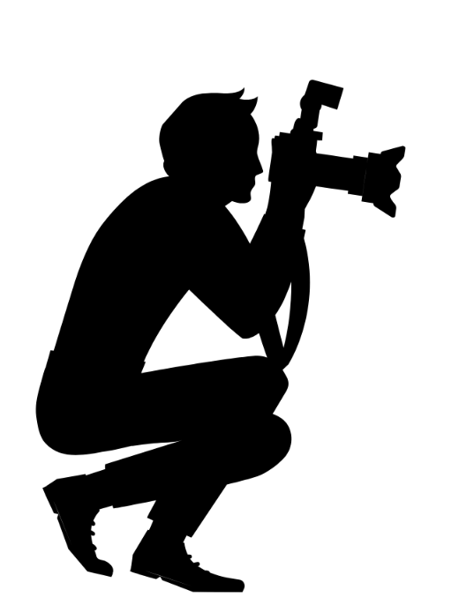

Owned Media
Earned Media
Engaging with target audience through Social Media
SEO, relevant & credible content on website
Promote events on social media and website
Event photographers
Newspaper coverage
Press releases
Word of mouth
Chloe Lourenco-Lang

Slide 20
We will need to publish content for each buyer persona at different stages of the buyer's journey
Paid Media
Owned Media
Earned Media
What we are going to do
Brand Awareness
Generate awareness and boost brand relevance
Place advertisements on the vehicles use most often
Boost Engagement
Encourage 18-24 year old’s to sign up and visit our website or download app
  Brand Image
Build positive brand image which will lead to new and current users promoting the app
Networking Event
Creating engaging content through IMC programs
How
Dana Bosland

Slide 21
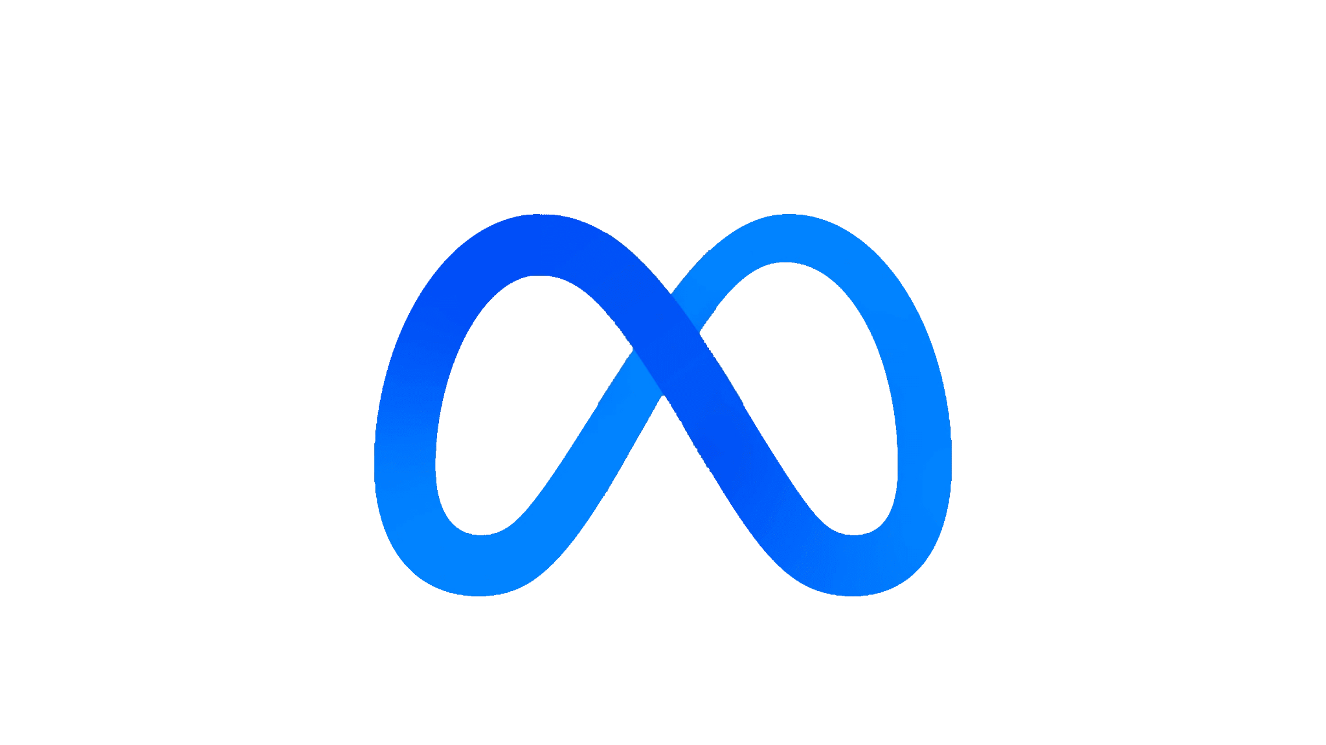
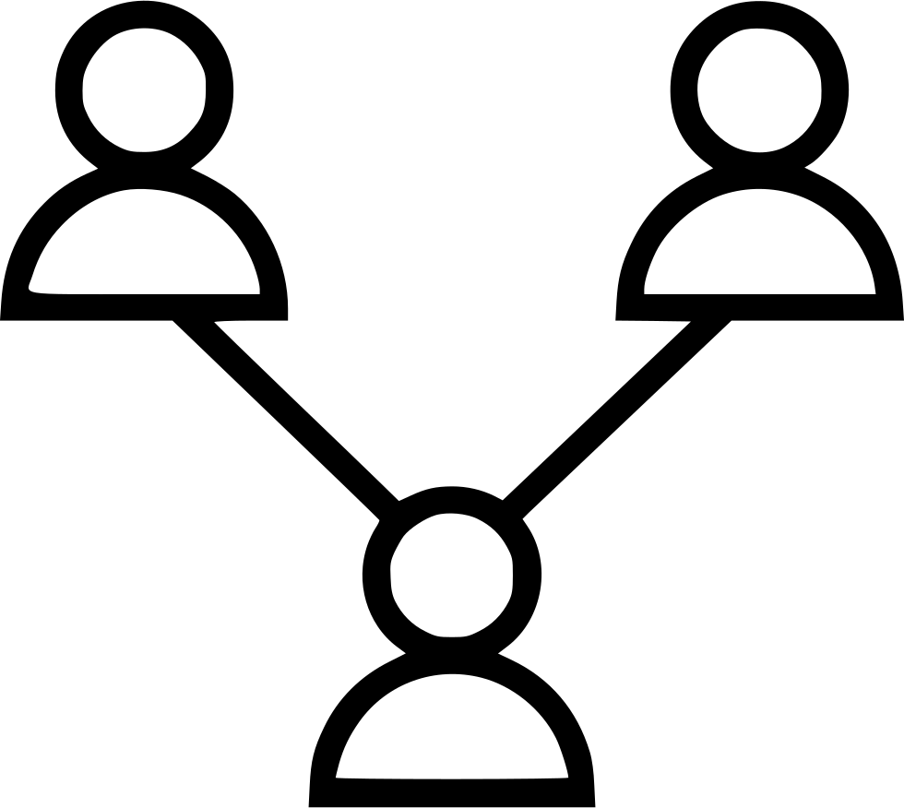



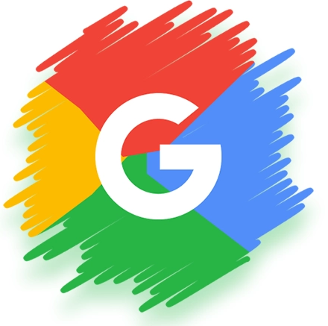
Which leads us to our Budgeting Breakdown
Networking Event
Cost: $1 Million
Impressions: Approximately 20,000
Madison Square Garden
Builds brand loyalty
Facebook/Instagram
Cost: $2 Million
Impressions: Approximately 2 million
Cost per Click : $0.974
Twitter
Cost: $1 Million
Impressions: Approximately 500,000-250,000
$2-4 per action (follow, retweet, etc.)
YouTube
Cost: $2 Million
Impressions: 100 Million
$2,000 per 100,000 viewers
Print
Cost: $500,000
Impressions: Approximately $81.3 Mil per ad
Estimated ad rate: $177,850
Around 3 ads in People’s
Google
Cost: $1 Million
Impressions: 500,000
Cost per Click: $2
Logan Jonathan

Slide 22
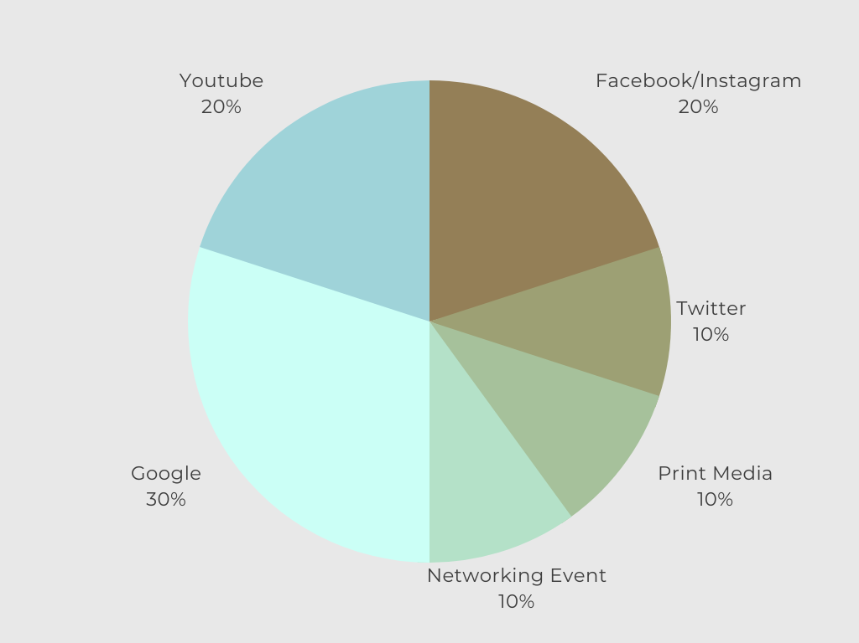
With a graph showing the percentage breakdown
Logan Jonathan

Slide 23
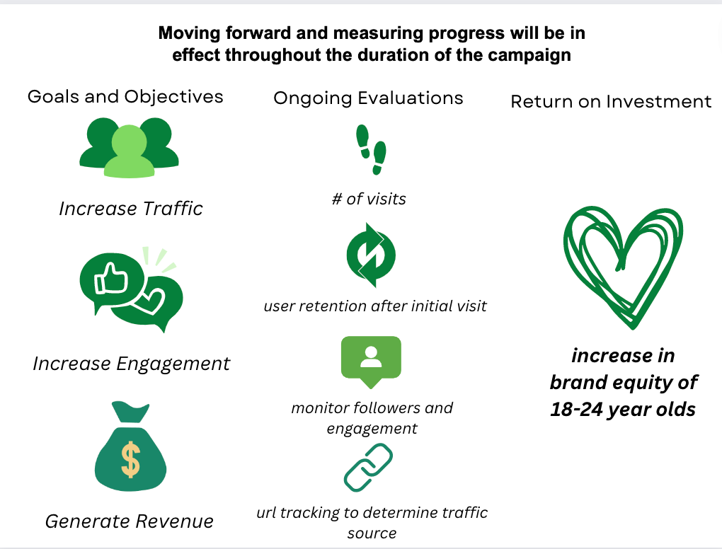

Slide 24


With a new allocation of a…
$12M Budget
Podcasts
Social Media
Content Creation
Events
SEO
or with a smaller allocation of only…
$8M Budget
No print media
Smaller networking event
Chloe Lourenco-Lang

Slide 25
Thank You!
Any questions?
You can reach us at @ProMotivateMedia and ProMotivateMedia@gmail.com

